Slide 1
Integration Hub
Design Overview

Slide 3
Current Data flow

Slide 4
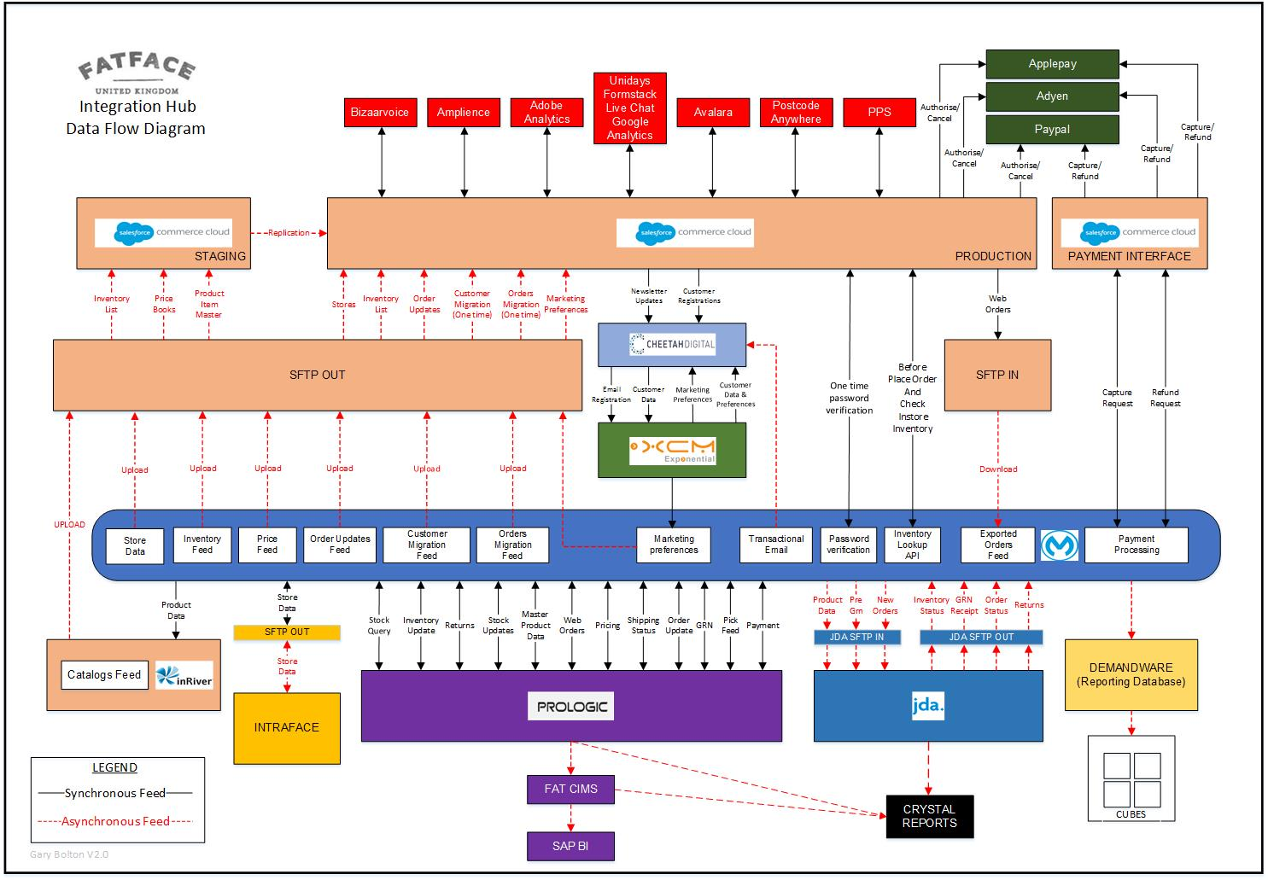
TO-BE Data flow

Slide 5
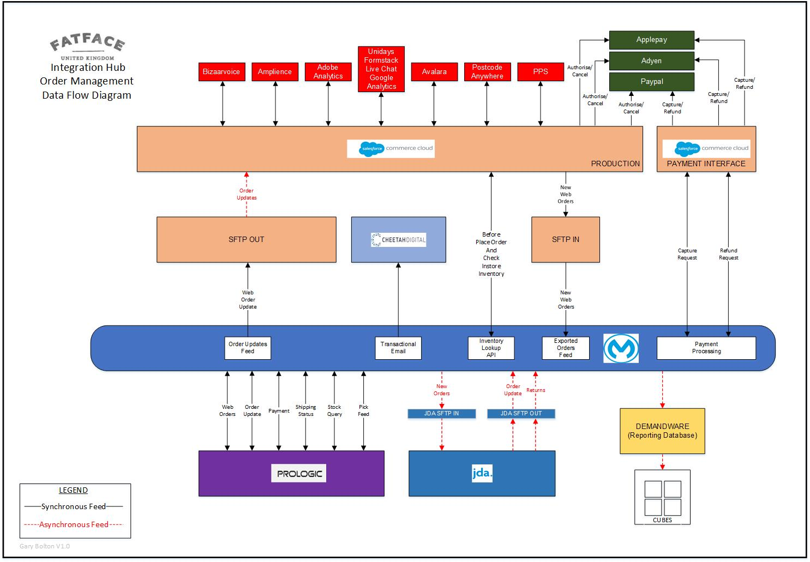
Order Management Data flow

Slide 6
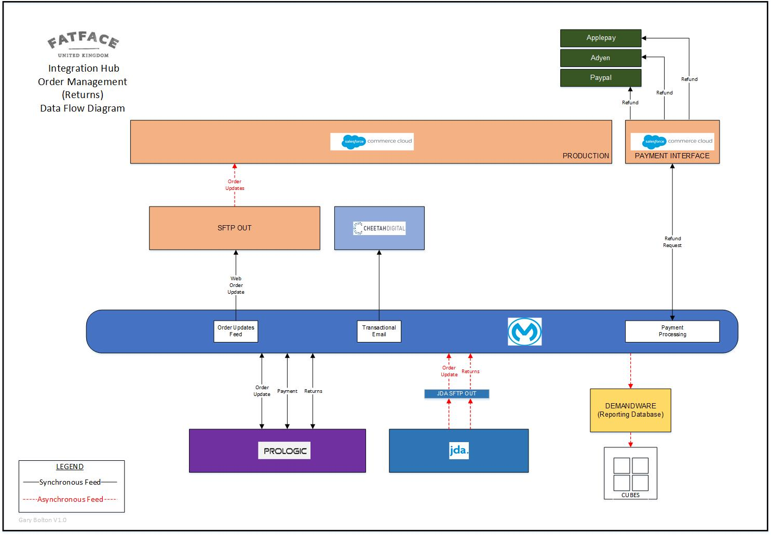
Returns Data flow

Slide 7
Pre-GRN Data flow

Slide 8
Stock Adjustment Data flow

Slide 9
Product Data flow

Slide 10
Pricing Data flow

